Slide 1
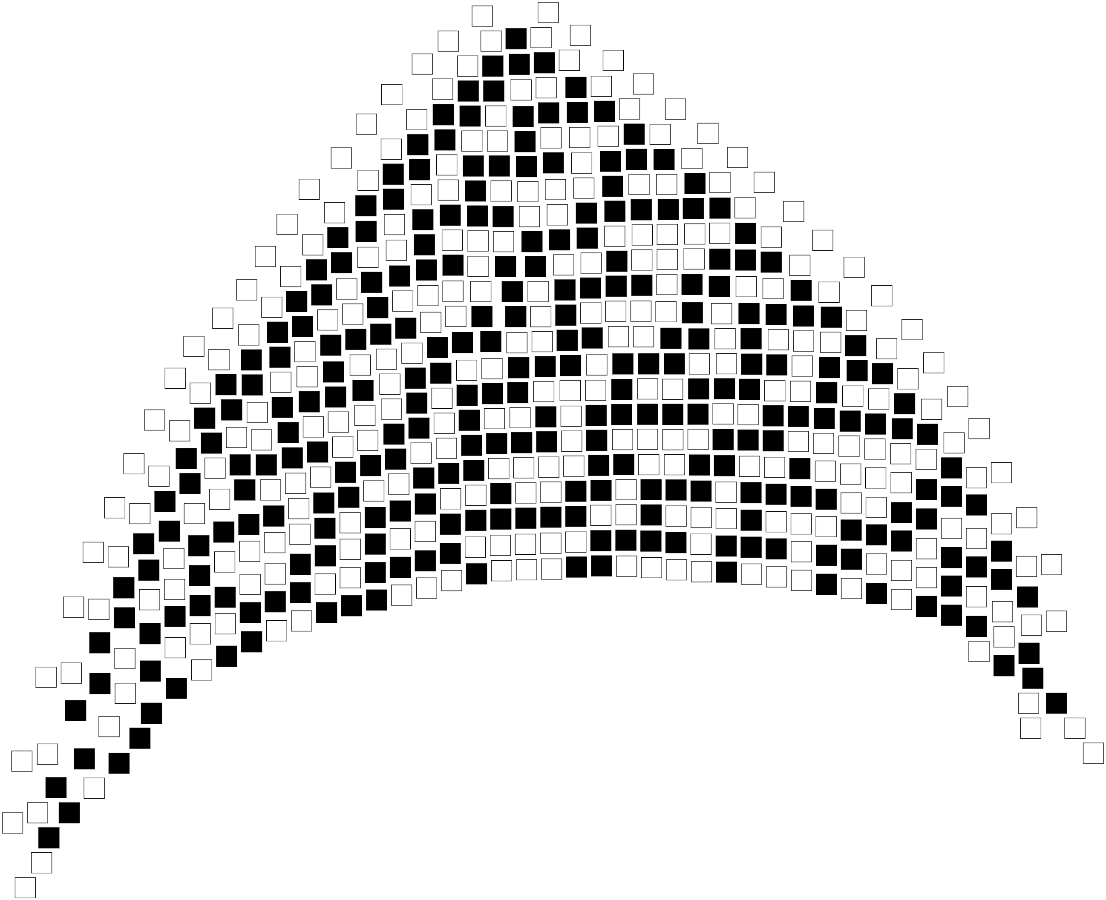
Graph grammars and failure in language design
Mark Gritter (he/him)
Twitter: @markgritter
Minnebar 15

Slide 2
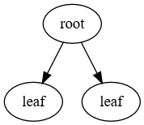
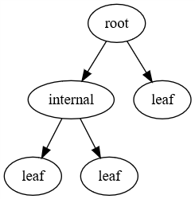
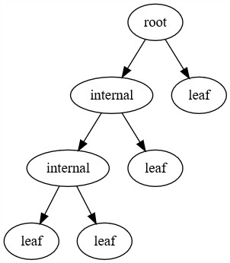
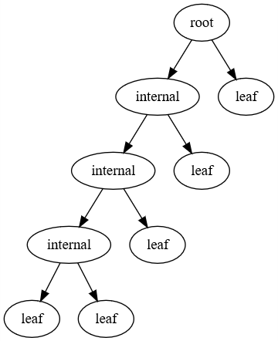
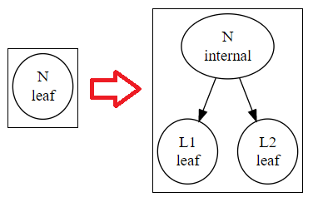
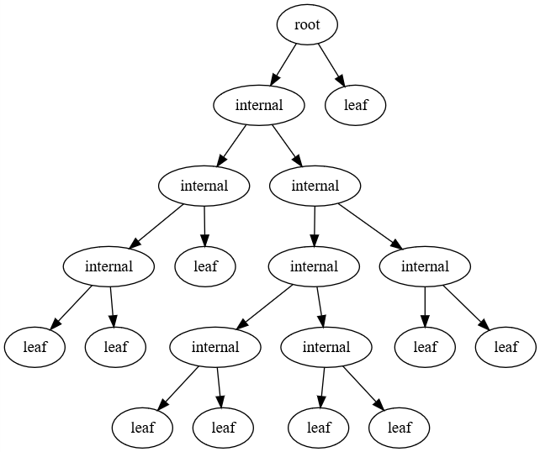
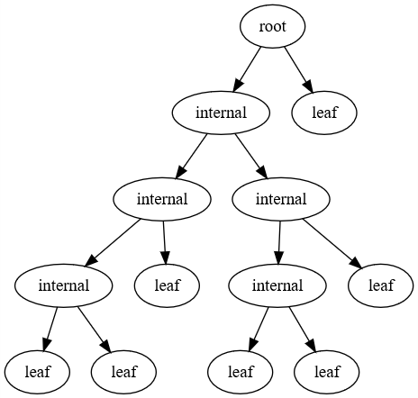
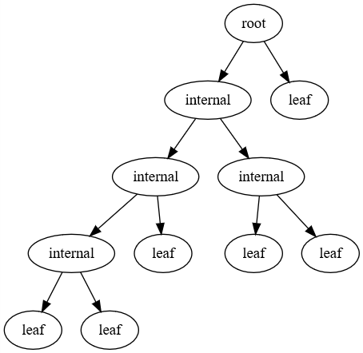
What’s a graph grammar?
Here’s one! (You can play with it at http://soffit.combinatorium.com/)
Left side
(match)
Right side
(production)
…
Notes:
A graph grammar consists of a set of graph rewriting rules. It’s like a context-sensitive grammar, but it operates on graphs instead of strings.
The left hand side is a graph to match. The right hand side shows how to transform that graph. In this example, we find a node labelled “leaf” and change its label to “internal”, then add two more leaves. You can see 12 iterations of this rule on the right.

Slide 3


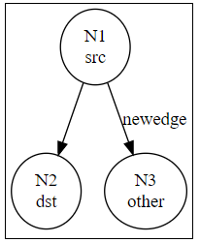

Graph grammar
aka “Graph Rewriting System”
A set of production rules for labeled graphs
Match some subgraph
Apply a transformation
relabel
add
delete
Notes:
More formally, a graph grammar or “graph rewriting system” is a set of production rules for labeled graphs. We can relabel the nodes and edges, add components, delete them, or merge nodes. So what are they useful for?

Slide 4
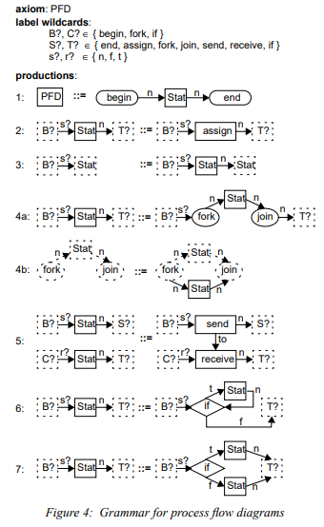
Visual languages
A syntax for visual languages!
Grammar from: J. Rekers and A. Schurr. 1995. A graph grammar approach to graphical parsing. In Proceedings of the 11th International IEEE Symposium on Visual Languages (VL '95). IEEE Computer Society, USA, 195.
Notes:
Graph grammars can be a syntax for a visual language, just like context-free grammars provide the syntax for textual languages.

Slide 5
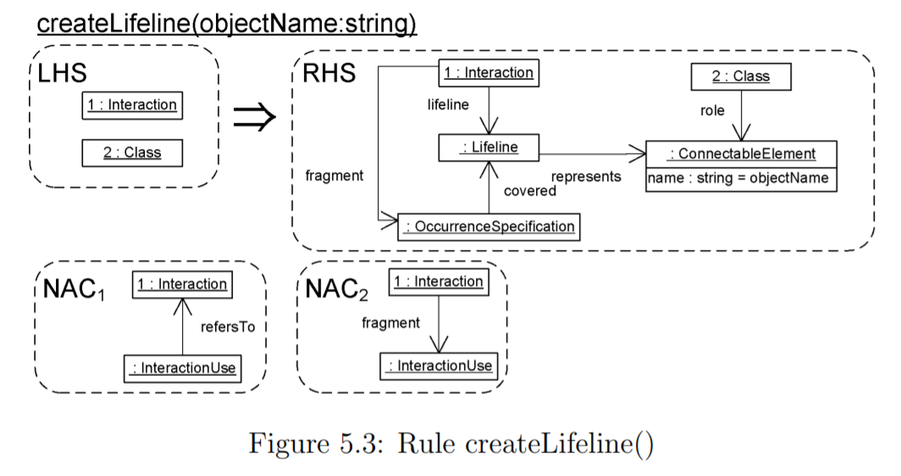
… like UML!
Frank Hermann, 2006. A typed attributed graph grammar for syntax-directed editing of UML sequence diagrams.
Notes:
Here’s an example graph transformation that helps edit UML diagrams.
(The graph grammar Dr. Hermann used in his PhD thesis is somewhat more complicated, it has “negative acceptance criteria”, features that should not be present.)

Slide 6
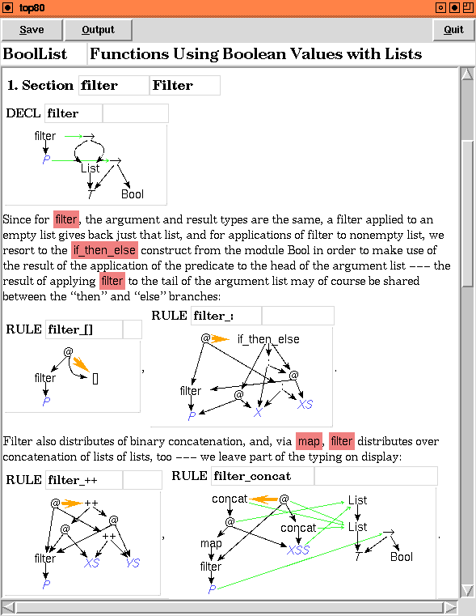
Code analysis and rewriting
http://www.cas.mcmaster.ca/~kahl/HOPS/
HOPS is intended as:
Research tool: New languages can easily be constructed and experimented with via the transformation mechanism.
Programming tool: HOPS may be used as a ``better Haskell editor'', integrating syntax directed editing with strong online typing.
Visualisation and debugging tool: Automatic evaluation sequences help to illustrate the workings of, for example, purely functional programs with lazy evaluation.
Notes:
Even textual computer code can be understood as an abstract syntax tree, which is a type of graph, or as a “term graph”. Here’s an image from HOPS, a system for working with term graphs that provides the capabilities to transform code and visualize it.

Slide 7
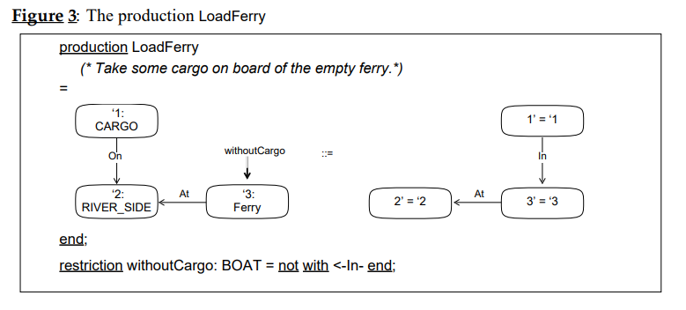
a model of concurrent or nondeterminstic programming
Graph grammar productions can operate on any match found, and in any order.
Albert Ziindorf, I., & Schiirr, A. (1991). Nondeterministic Control Structures for Graph Rewriting Systems.
Notes:
Many graph grammars allow nondeterminstic execution; any rule that matches may be applied. So they’re an interesting model for concurrent or randomized execution. Shown here is an example production rule that’s part of the sheep-wolf-cabbage problem.

Slide 8
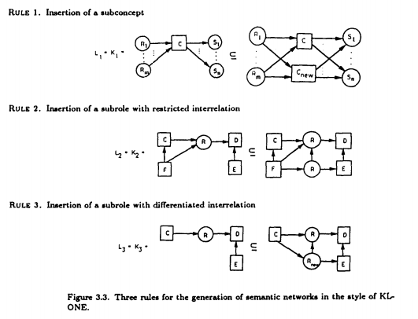
Creating networks
Hartmut Ehrig, Annegret Habel, and Hans-Jörg Kreowski. Introduction to graph grammars with applications to semantic networks. Computers & Mathematics with Applications, 23(6-9):557–572, 1992
Notes:
The side of things I’m most excited about is their ability to create graphs, and other content that can be represented as graphs! Here’s an example of rules to produce a semantic network.

Slide 9
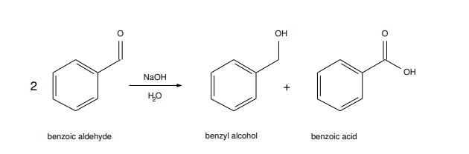
Creating molecules
rule [ ruleID "cannizzaro reaction too general" context [ node [ id 1 label "C" ] node [ id 2 label "O" ] node [ id 3 label "H" ] node [ id 4 label "O" ] node [ id 5 label "C" ] node [ id 6 label "H" ] node [ id 7 label "H" ] node [ id 8 label "H" ] node [ id 9 label "O" ] edge [ source 1 target 7 label "-" ] edge [ source 4 target 8 label "-" ] edge [ source 5 target 9 label "=" ] ] left [ edge [ source 1 target 2 label "=" ] edge [ source 3 target 4 label "-" ] edge [ source 5 target 6 label "-“ ] right [ edge [ source 1 target 2 label "-" ] edge [ source 2 target 3 label "-" ] edge [ source 4 target 5 label "-" ] edge [ source 6 target 1 label "-" ] ] ]
https://www.tbi.univie.ac.at/software/GGL/
“Graph Grammar Library”:
Beside its general applicability, it features an extensive chemistry module to handle grammar-based graph transformation in Chemistry. Since a chemical reaction can be viewed as graph transformation from the set of educt graphs to the set of product graphs, the GGL can be used to iteratively expand the topology of chemical reaction network, starting from a set of chemical reactions (graph rewrite rules) and set of molecules (vertex and edge labeled graphs) using the general DPO framework of the GGL.
Notes:
Molecules can be represented as graphs, so chemical reactions are graph transformations! Here’s one on the right, in a syntax even worse than mine.

Slide 10
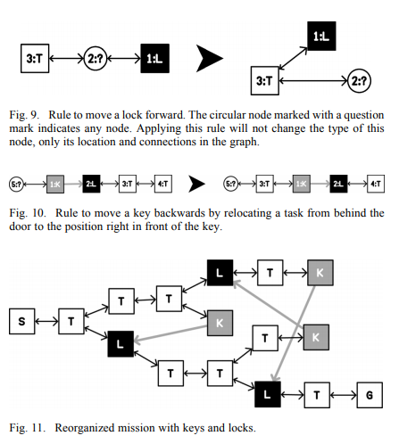
Creating dungeons
Joris Dormans and S. Bakkes, "Generating Missions and Spaces for Adaptable Play Experiences," in IEEE Transactions on Computational Intelligence and AI in Games, vol. 3, no. 3, pp. 216-228, Sept. 2011.
“Cyclic Dungeon Generation”: https://www.youtube.com/watch?v=mA6PacEZX9M, the basis behind the game “Unexplored”
Notes:
One recent use of graph grammars is in the game “Unexplored”. Joris Dormans published work on creating missions and spaces with graph grammars, then applied it in the design of the game. He didn’t publish direction on “Unexplored” but the YouTube video from ProcJam is very good.

Slide 11
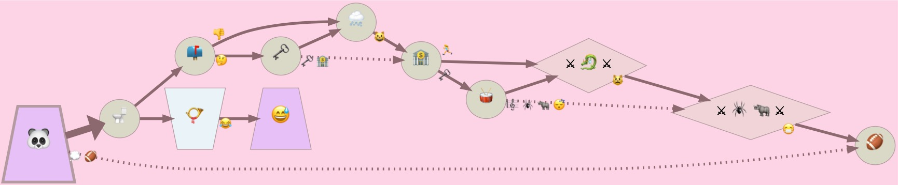
Creating adventures
https://twitter.com/tinyperil by Ian Holmes
Built with: https://github.com/ihh/graphgram
“The epic Thrash metal of the Red and the disgusting construction worker”
Notes:
A more recent effort along those lines is the twitter bot “Tiny Peril” which creates adventure-like graphs. Ian Holmes wrote a small Javascript graph grammar engine that’s the basis of this work.

Slide 12
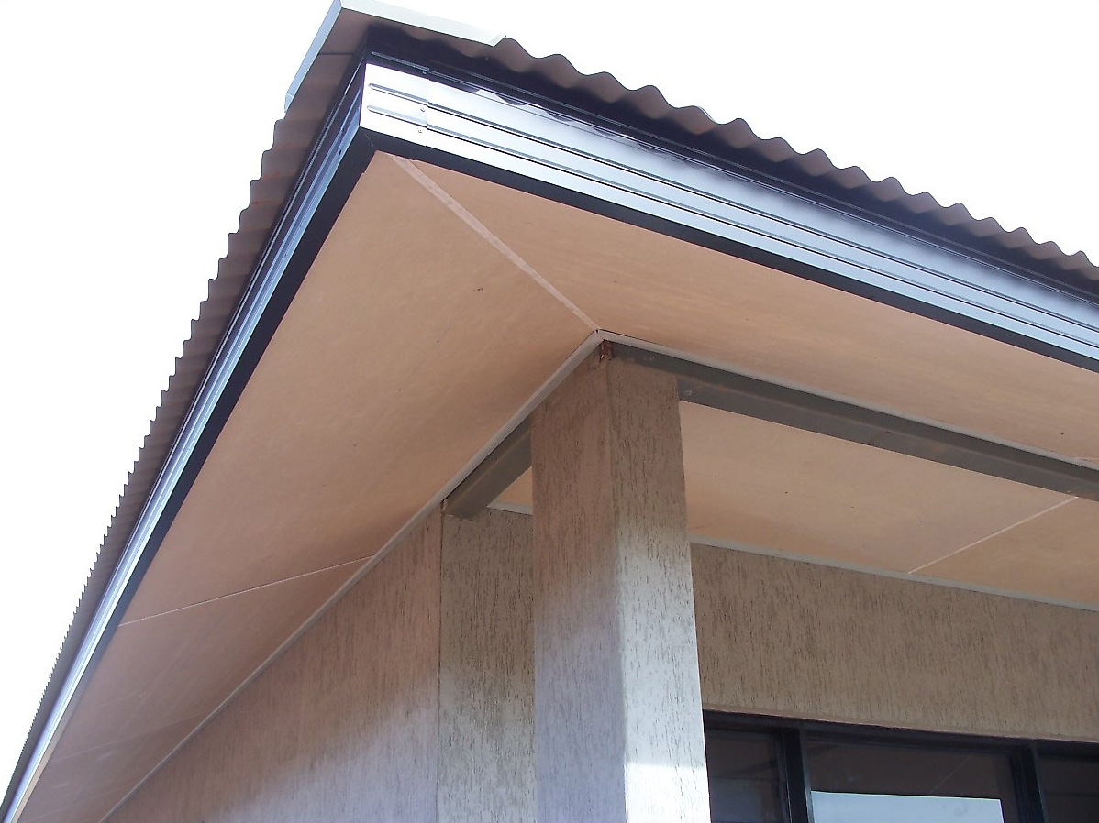
Great! How Do I get Started?
There are several very good implementations, but it turned out I hated them all.
Large integrated environment (like PROGRES) or big libraries with complicated syntax.
How would I ever manage to embed one in a small generative art project, like the MetaArtBot? http://artbot.combinatorium.com/
Inspiration: Tracery: https://tracery.io/
So I picked the name “Soffit”

Slide 13
Soffit
I already knew Graphviz’s Dot language, so graphs in Soffit are written in Dot syntax, sort of.
X[x]; P[x]; P1[x]; C[cursor]; X->C [h]; P->C[v]
Node name
Tag
Directed edge
Notes:
A graph in soffit has named vertices, with tags attached to vertices or edges.

Slide 14
Soffit [2]
Graph grammars are JSON objects:
{
"version": "0.1",
"X--Y [?]": [
"X--Y",
"X; Y"
],
"start": "A--B--C--D--E--A--D--B--E--C--A [?]"
}
Notes:
Following Tracery’s design, graph grammars in Soffit are JSON objects with the left hand side as the key, and the right hand side is the value (or a list of values, each of which could be used.) Here’s a simple Soffit grammar that generates a random graph with 5 vertices.

Slide 15
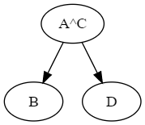
Soffit extensions to dot syntax
Bidirectional arrows and chaining
"A->B->C<-D [tag]": "A->B; C<-D;"
Merge two nodes
"A->B [tag]; C->D [tag]": "A^C; A->B; C->D"
Unicode/Emoji as tag and node names
"六->七 [🙂]"
Graphviz integration: attributes are rendered without quoting
“X[color=red; style=filled]"
Notes:
There are a few additions to the Dot syntax. One is that edges can be chained together, or written in the opposite direction.
The caret character, standing for “join” specifies that two vertices should be merged together in the right-hand side of a rule.
Like Swift, nearly any Unicode character is a valid identifier.

Slide 16
Soffit’s nondeterminism
Shuffle all the rules
Try each rule in this random order
If it has multiple right-hand sides, shuffle them too
If there’s a valid match, pick randomly from all valid matches (up to 1000)

Slide 17
Soffit implementation
Soffit is implemented in Python
https://github.com/mgritter/soffit
Command-line tools:
Execute a graph grammar (or sequence of them) and plot the result as an SVG
Show a rule set as an HTML page
Online version built later, with AWS Lambda.

Slide 18
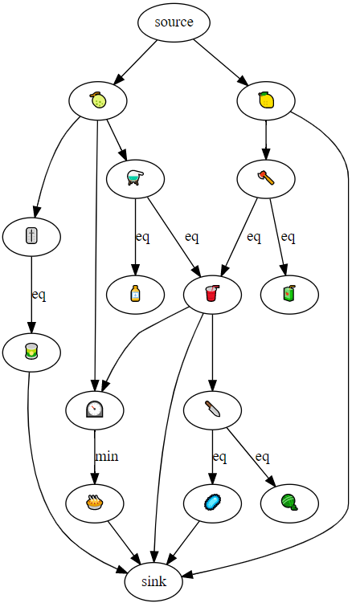
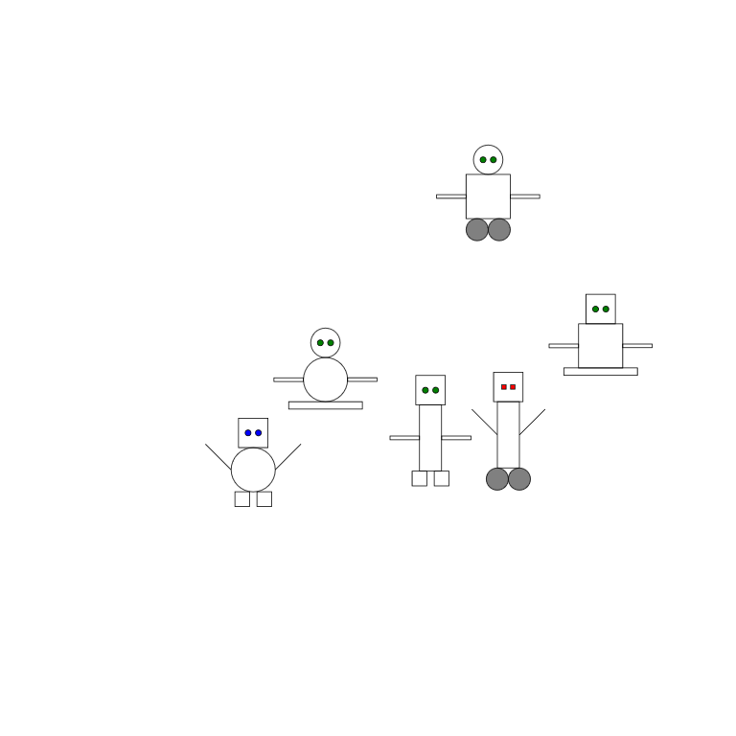
Projects
Emojiconomy: github.com/mgritter/emojiconomy
See my Roguelike Celebration 2020 talk!
SVG output from a Soffit grammar: github.com/mgritter/svgrammar
Advent of Code in Soffit (not recommended): github.com/mgritter/aoc-soffit
Notes:
So, I was successful at using Soffit in other projects! I built a system called Emojiconomy that builds toy economies, which I talked about at this year’s Roguelike Celebration last week.
I’m working on an extension that produces SVG output, shown here creating some small robots. As a stunt, I tried to use Soffit to solve Advent of Code problems last year and I did manage to solve a few, but very slowly because the graphs get large.

Slide 19
Mistakes
JSON sucks.
No comments! (at least, not with Python’s default parser)
Constant comma problems
No newlines! Very difficult for large rules
I didn’t write the implementation in JavaScript anyway
Left and Right usually share a lot
Other tools have a separate “context” section
No templating for tags
Dozens of versions of the same rule
Notes:
Also, no way to name rules for debugging

Slide 20
Example
"COMMENT[these rules don't have a stopping point. They also blow away some next_char arrows, which may be a bug.]" : "", "X[token]; Y[token]; XX[letter]; YY[letter]; X->XX; Y->YY; XX->XX [0]; YY->YY [0]" : "X[token]; Y[token]; XX[letter]; YY[letter]; X->XX; Y->YY; XX->XX [0]; YY->YY [0]; X--Y [eq]",
"X[token]; Y[token]; XX[letter]; YY[letter]; X->XX; Y->YY; XX->XX [1]; YY->YY [1]" : "X[token]; Y[token]; XX[letter]; YY[letter]; X->XX; Y->YY; XX->XX [1]; YY->YY [1]; X--Y [eq]“, "A1[token]; A2[token]; A3[token]; B[)]; C1[token]; C2[token]; C3[token]; LINE[line]; LINE->A1->A2->A3->B->C1->C2->C3 [next_char]; C3->LINE [end_of_line];" : "LINE[line]; X[body]; Y[body]; Y->X [orbits]; X->A1 [p1]; X->A2 [p2]; X->A3[p3]; Y->C1 [p1]; Y->C2 [p2]; Y->C3 [p3]; A1[token]; A2[token]; A3[token]; C1[token]; C2[token]; C3[token];“ "A[+1]; B[+10]; A->B [next_char]" : "A[+10]; B[+1]; A->B [next_char]", "A[+1]; B[+100]; A->B [next_char]" : "A[+100]; B[+1]; A->B [next_char]", "A[+1]; B[+1000]; A->B [next_char]" : "A[+1000]; B[+1]; A->B [next_char]", "A[+1]; B[+10000]; A->B [next_char]" : "A[+10000]; B[+1]; A->B [next_char]",
Notes:
Here are some examples from the Advent of Code solutions. One technique I developed is to have left and right hand side of different lines so I could visually align them to highlight the changes. But think of like, 8 more rules exactly like this. You can see some rules get extremely hairy and a line break would really help.

Slide 21
Mistakes?
Python is fine for me, but probably still the wrong language for embedding
JavaScript?
Lua?
I decided matches would be “injective” and then discovered cases where I didn’t want that.
Can we make an implementation simple enough so that everybody can copy it?
Tracery has ports in every language you can think of
Probably not… I made heavy use of NetworkX and a constraint solver
Notes:
Some things I’m less clear are mistakes, although they are signs that my language did not meet its design goal. I like Python, but in terms of my design goals to create something embeddable, it’s still too much. Lua would be a better choice, or maybe JavaScript.
Soffit ensures that each node on the left matches distinct nodes in the in the graph, because I thought that would be simpler to understand, but then I discovered cases where I wanted that! Like, if you’re going to parse symbols and have only one version of each, suddenly injectivity means you can’t match the pair “A, A”.
Tracery has ports to every language you can think of; would it really be feasible to do this with Soffit? Not as it currently stands.

Slide 22




Category theory?
Algebra for graph rewriting
Double Pushout (DPO):
Restricted deletion
Single Pushout (SPO):
Unrestricted deletion, “partial morphisms”
No dangling edges
No half-dead nodes
(non-injective matchings only)
Other options: SQPO, AGREE, PBPO
Notes:
OK, let’s talk about Category Theory, which provides a model for how graph grammars work. But really the practical impact can be expressed in this one page. A “DPO” is an older model that specifies how to handle deletion. You can’t delete a vertex if it would leave an edge dangling, and you can’t simultaneously delete a node or edge and not delete it. (This only occurs if nodes in the rule can match the same node in the graph.) Nearly everybody who writes about DPO will take pages to explain these two rules, but in practice they’re pretty easy to understand.
A “SPO” operates on a more complicated category (that has partial functions instead of total functions) and allows unrestricted deletion.

Slide 23
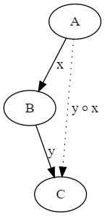

A very short introduction to categories
A category is a collection of dots (objects) and arrows (morphisms), with the rules:
Every pair of head-to-tail arrows can be joined to create a new arrow
This rule is associative
Every dot has an identity arrow
Every category is a multigraph, but not all graphs are categories.

Slide 24
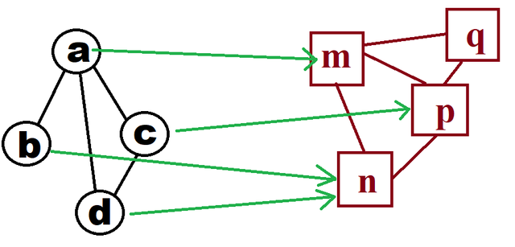
The category of graphs
Here’s one of its morphisms (the green arrows): Note that this is not a function between arbitrary graphs, it’s just a set of mappings between two particular graphs.

Slide 25

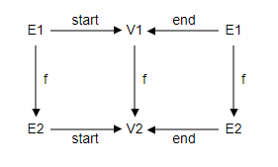
The Category of Graphs [2]
We can think of a directed graph as:
a set of vertices
a set of edges
and a pair of functions “start” and “end” mapping edges to vertices.
A graph morphism maps vertices to vertices, and edges to edges, so that “start” and “end” in each graph match up.
A commutative diagram: any two ways of combining the arrows are equal.

Slide 26
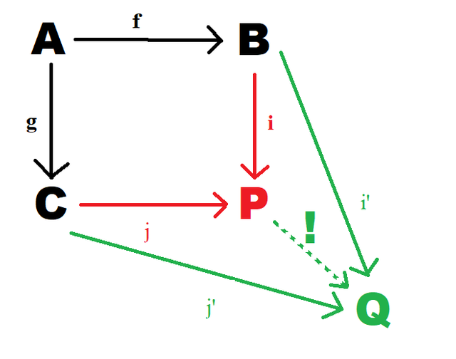
Pushouts
A pushout is an object that has a “universal property”.
Think of it as a machine:
Inputs: A, B, C, and the morphisms f: A->B and g : A->C
Outputs: P and the morphisms i:B->P and j:C->P that make a commutative square
Special property: if ABCQ commutes too, then there’s a unique morphism P->Q that makes everything commute.
It’s the “smallest” P that works.
Notes:
Pushouts aren’t guaranteed in every category, but directed graphs have them.

Slide 27
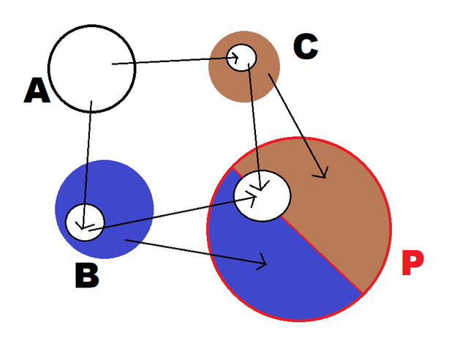
Pushouts in Set
Start with a disjoint union
P “remembers” which of B or C each element came from, unless they were originally from A.

Slide 28
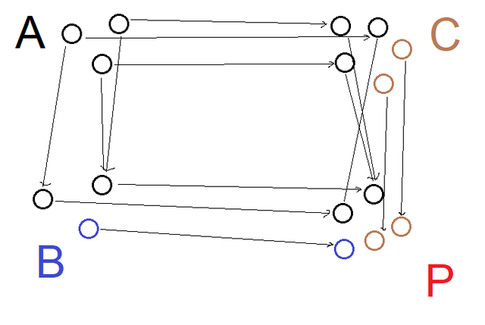
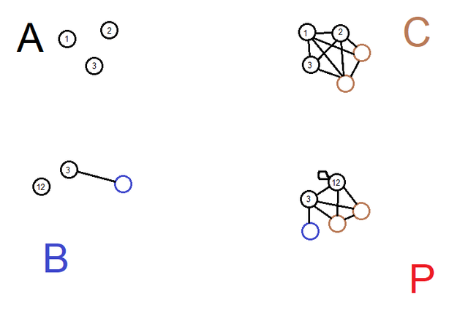
Pushouts on graphs
P is the minimal graph that:
contains (an image of) all of B
contains all of C, but
merges the image of A in both graphs

Slide 29
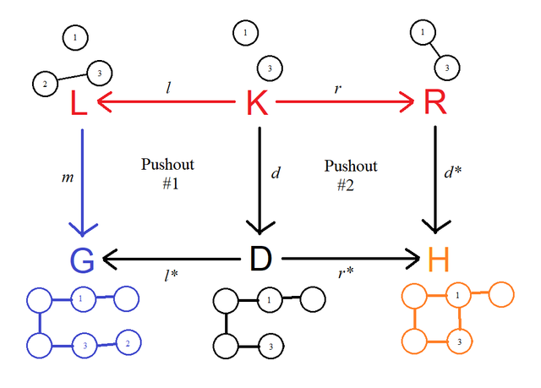
double Pushout
L is the left side of the rule
R is the right side of the rule
K is the left side but with elements deleted (so K->L is an injective map)
G is the input graph
D is the matched portion of G, with nodes deleted.
H is the result of performing all the addition in R.
Notes:
Pushout #1 is the machine run in reverse. We want G to be the pushout, so we find a D that makes it one!
Pushout #2 is the single-pushout that doesn’t have any deletion.
All this is just a fancy mathematical way of saying that the DPO rules hold.

Slide 30

Thanks!
Try Soffit online:
http://soffit.combinatorium.org or https://mgritter.github.io/soffit-web
I’ve been meaning to link some examples, for now you can find them in my Gists: https://gist.github.com/mgritter
Check out the source code: mgritter/soffit on GitHub
These slides: mgritter/minnebar-talks on GitHub
Twitter: @markgritter In RL:

Slide 31
What’s next for Soffit?
Format rewrite
Keep the DOT-like syntax, but…
Provide a way to name rules and add comments
Compact representation for the “context”
Meta-rules
Fuzzy idea: rules are graphs too, generate new rules via graph transformations? "A->B [$n1]; C->D [$n2]": "...", "X->Y [$n]" : ["X->Y[1]","X->Y[2]",...]

